Slide 1





TravelGenie
EU24282342

Slide 2



PROBLEM
The Hassle of
TRAVEL PLANNING
In today's fast-paced world, organizing a trip has become an increasingly daunting task. Travelers are inundated with a plethora of options for accommodations, flights, and activities, forcing them to spend countless hours manually searching across different platforms to piece together suitable itineraries. This process often results in frustration, loss of precious time, and even budget overruns, leaving travelers unsure if they've made the best choices.
Key
CHALLENGES
Lack of Personalization
Managing multiple bookings across fragmented platforms.
Real-Time Information
Budget Constraints
Current platforms offer generic recommendations that frequently fail to align with individual traveler preferences and interests.
Travelers require timely updates on flight changes, hotel availability, and destination specific information to make proper decisions.
Many travelers exceed their budget, overspend due to inadequate planning tools.
Insufficient tools for group expense management.
They need to use different websites, apps, or services to book various components of their trip like flight,hotel & Activities.

Slide 3


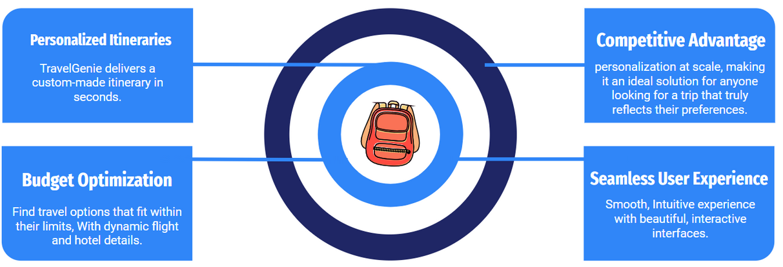




Solo traveler to Vietnam
SOLUTION
UNIFIED AI-POWERED TRAVEL PLATFORM
Personal AI Travel Assistant
USP
Family
vacations at
Dubai
itinerary
Group Travel Collaboration
AI-Powered Personalization
Real-Time Travel Insights
All-in-One Platform (Flight+Hotel+ Activities) with with Club Booking for all.
Shared wallets for pooled expenses, Voting tools and collaborative itinerary creation
Shareable via whatsapp
All-in-One Booking
System
Real-Time Updates
Instant notifications for flight changes, hotel, and events, Destination-specific insights like weather updates and travel advisories
Book flights, hotels, and activities on a single platform, with competitive pricing
Eco-Friendly Features
Value Proposition:
For Partners:
Increased visibility and revenue through exclusive partnerships.
Access to actionable user insights to improve their offerings.
For Users:
Time-saving, hassle-free planning with custom itineraries.
Budget-friendly deals and real-time updates for informed decision-making.
An end-to-end travel experience curated from booking to on-the-ground exploration.
Carbon Footprint Calculator
Carbon Offset Program
Promoting Group Travel
Hosted on energy-efficient cloud providers
Gamified Sustainability

Slide 4
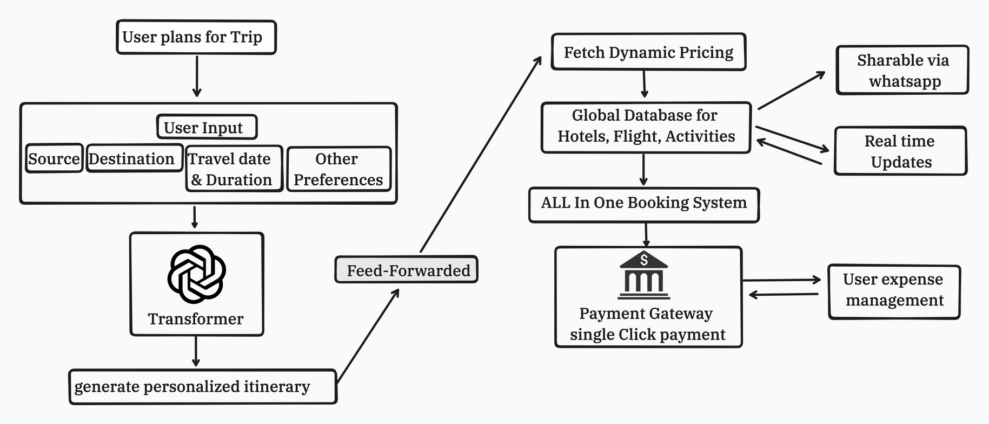



& ARCHITECTURE
Tech stack

Slide 5

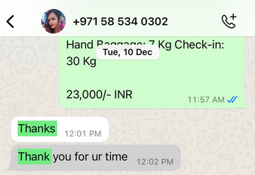
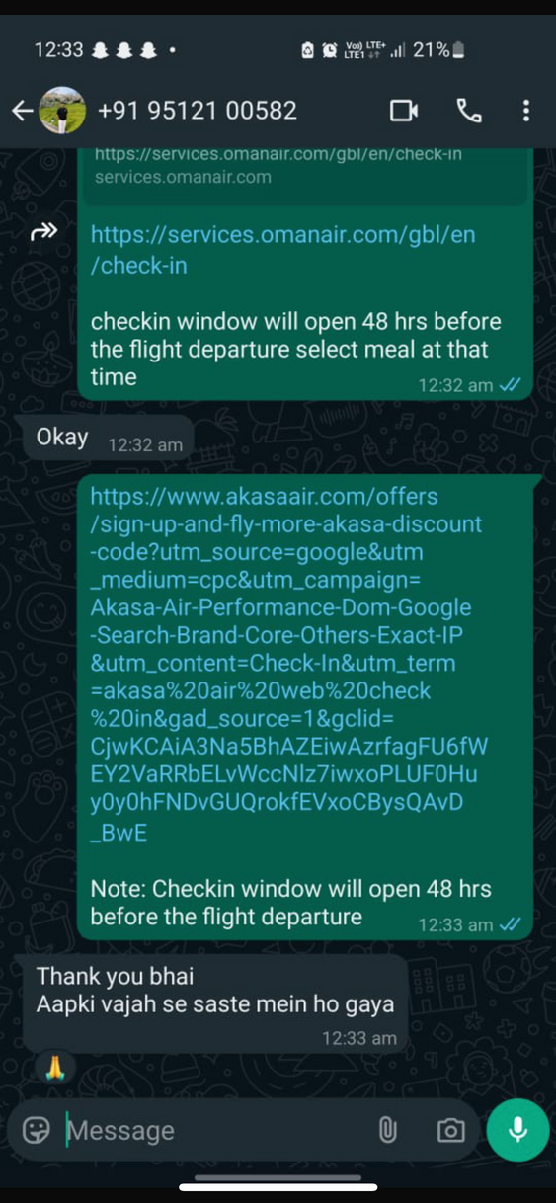
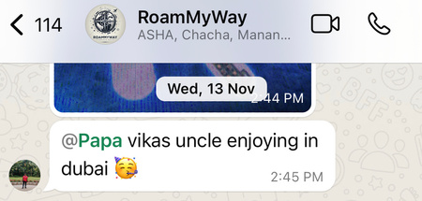
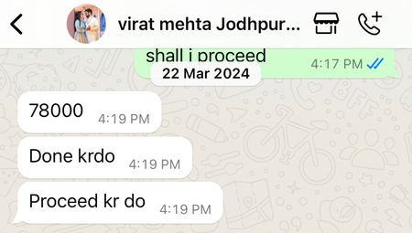
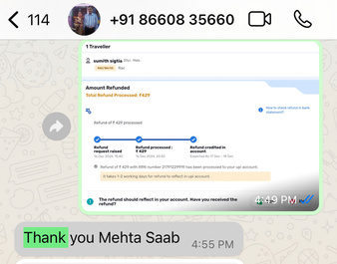
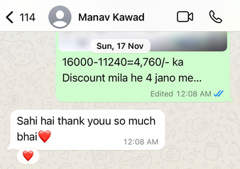
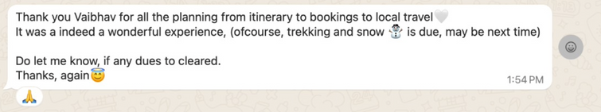
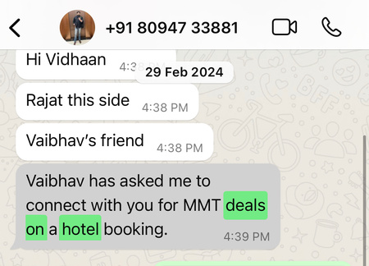
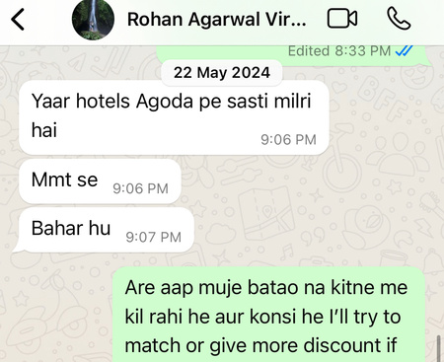
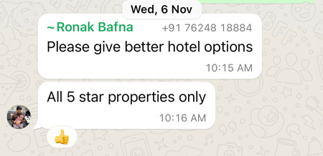
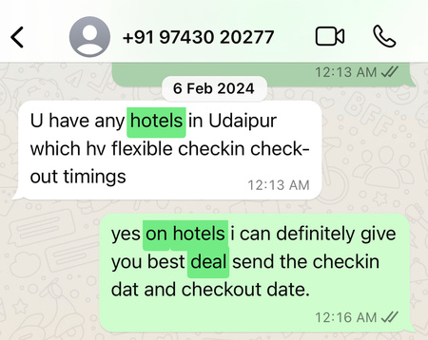
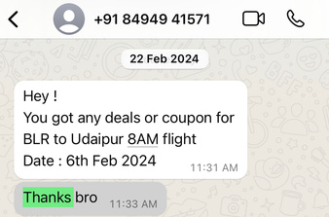
Global Online Travel Booking Market
MARKET
projections to reach USD 1.1 trillion
by 2032, CAGR of over 7% yearly
TAM
$ 600.5 billion
Target Market Customer Segments
Customer feedbacks: Manual bookings Done
SAM
$ 100 billion
a. Demographic Segmentation:
Age Group: Individuals aged 25-45.
Income Level: Middle to upper-middle-income.
SOM
$ 100 million
b. Psychographic Segmentation:
Frequent Travelers: Who travel regularly for business or leisure and seek convenience in booking.
Experience Seekers: Curated activities and unique experiences
Key Channels to Engage and Retain Customers:
Social Media Marketing
Website and Mobile App
Partnerships
Influencer marketing
Email and SMS Marketing
Corporate Collaborations
Referral Programs
SOM
$100 million
c. Behavioral Segmentation:
Online Bookers
Last-Minute Planners
Convenience of an end-to-end travel solution.
Offer free trials or freemium models to let users
experience the value firsthand.

Slide 6
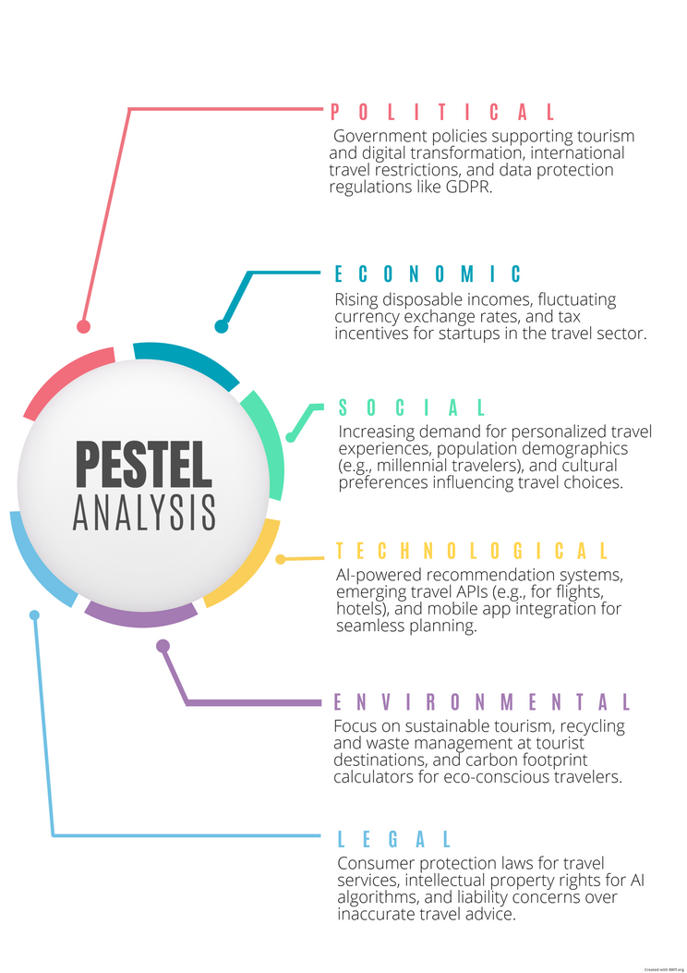
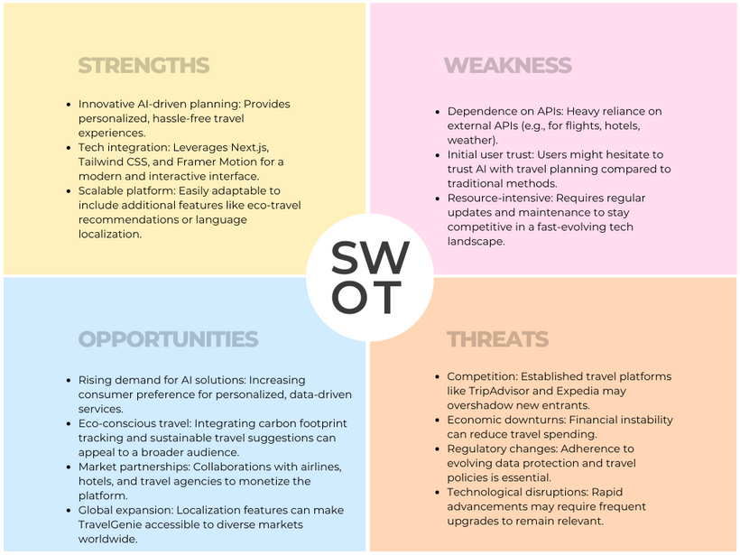
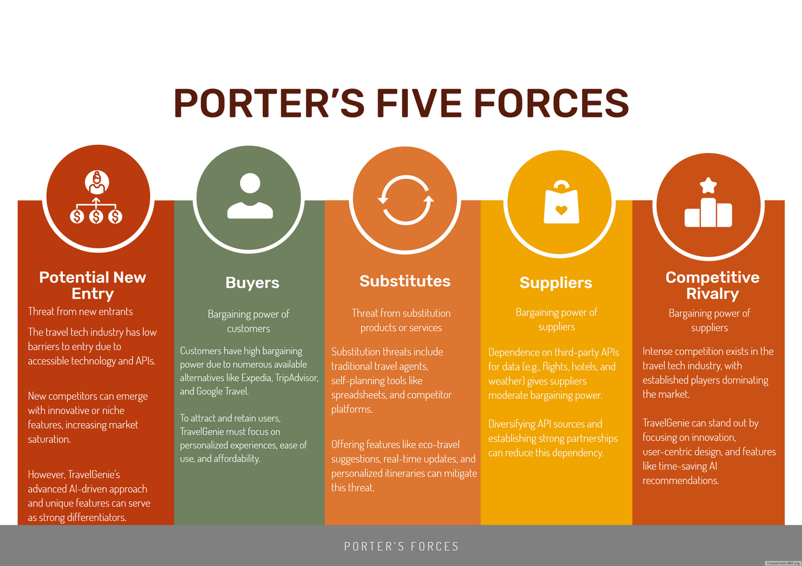
USER PERSONA
Segment 1: Young Explorers (18-25 years) | Tech-savvy college students and young professionals,
Value Proposition: Save time with quick, personalized | Channels Social Media Influencer platform
Segment 2: Family Travelers (30-50 years) | Parents and middle-aged individuals
Family-friendly destinations & accommodations.Activities catering | Facebook groups, Pinterest boards for family travel.
Segment 3: Luxury Seekers (35-60 years) | Affluent travelers and high-income professionals.
Luxury stays and private tours.Exclusive activities | VIP customer support for premium users

Slide 7
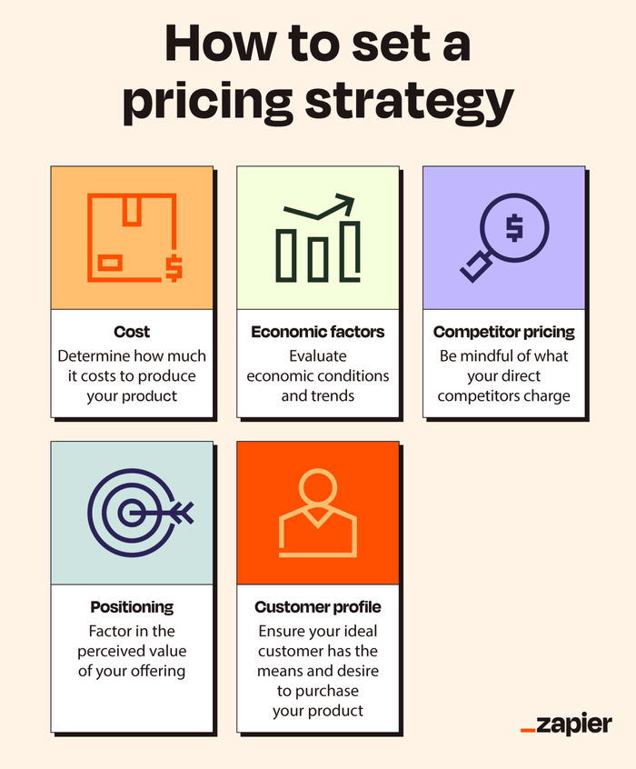
REVENUE
MODEL
Integrated Booking
PERSONALISED PLANS
TRAVEL PATNER’S
MICRO/MAJOR INFLUENCER’S
Data-Driven Insights
Commission-based earnings from partnered flights, hotels, and activity bookings. Dynamic pricing models leveraging AI to match user budgets and preferences.
Free tier with basic planning tools. Paid tiers offering enhanced personalization, exclusive deals, and concierge services.
by partnering with local travel agents, allowing us to offer on-the-ground expertise, exclusive local experiences and Advertisement partnerships & Sponsorships.
Use anonymized travel data (with user consent) to provide actionable insights to travel brands, enhancing their offerings.
collaborate with Travel influencers to amplify our brand reach for marketing and drive travel inspiration along with Trip Planning with Influencers and Corporate.
1. Projections:
Year 1: Launch by Feb2025.
Year 2: Target 1,000 to 5,000 users.
Year 3: Project 15,000 - 20,000 users.

Slide 8
OPERATIONAL COSTS &
REVENUE PROJECTION FOR 12-MONTH RUN RATE
Month | Salaries | Server Costs | Product Development | Marketing | Sales Team Expenses | Miscellaneous | Total Operational Costs | Hotel Booking Revenue | Flight Booking Revenue | Premium Plan Revenue | Other Revenue | Total Revenue | Net Profit/Loss
Month 1 | 500000 | 50000 | 150000 | 100000 | 75000 | 20000 | 895000 | 61250 | 50000 | 50000 | 20000 | 181250 | -713750
Month 2 | 500000 | 50000 | 150000 | 100000 | 75000 | 20000 | 895000 | 61250 | 50000 | 52000 | 21000 | 184250 | -710750
Month 3 | 500000 | 50000 | 150000 | 100000 | 75000 | 20000 | 895000 | 61250 | 50000 | 54000 | 22000 | 187250 | -707750
Month 4 | 500000 | 50000 | 150000 | 100000 | 75000 | 20000 | 895000 | 61250 | 50000 | 56000 | 23000 | 190250 | -704750
Month 5 | 500000 | 50000 | 150000 | 100000 | 75000 | 20000 | 895000 | 61250 | 50000 | 58000 | 24000 | 193250 | -701750
Month 6 | 500000 | 50000 | 150000 | 100000 | 75000 | 20000 | 895000 | 61250 | 50000 | 60000 | 25000 | 196250 | -698750
Month 7 | 500000 | 50000 | 150000 | 100000 | 75000 | 20000 | 895000 | 61250 | 50000 | 62000 | 26000 | 199250 | -695750
Month 8 | 500000 | 50000 | 150000 | 100000 | 75000 | 20000 | 895000 | 61250 | 50000 | 64000 | 27000 | 202250 | -692750
Month 9 | 500000 | 50000 | 150000 | 100000 | 75000 | 20000 | 895000 | 61250 | 50000 | 66000 | 28000 | 205250 | -689750
Month 10 | 500000 | 50000 | 150000 | 100000 | 75000 | 20000 | 895000 | 61250 | 50000 | 68000 | 29000 | 208250 | -686750
Month 11 | 500000 | 50000 | 150000 | 100000 | 75000 | 20000 | 895000 | 61250 | 50000 | 70000 | 30000 | 211250 | -683750
Month 12 | 500000 | 50000 | 150000 | 100000 | 75000 | 20000 | 895000 | 61250 | 50000 | 72000 | 31000 | 214250 | -680750
EBITDA (Annual): ₹-5,310,000 | Run Rate Profit (Annual): ₹-5,310,000 | Run Rate Profit (Monthly): ₹-442,500

Slide 9
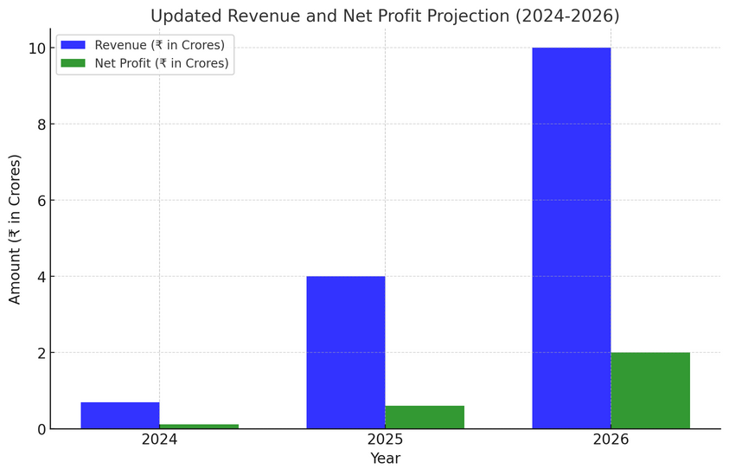
CURRENT STAGE
TILL LAUNCH
Progress
TO DATE
Year | Milestones/Features | Details
2024 (Dec) | Launch Preparation | - Finalize offline bookings and itinerary generation improvements.- Prepare for integrating flight, hotel, and activity booking systems.
2025 (Q1-Q2) | Booking System Integration | - Launch online booking system for flights, hotels, and activities.- Integrate payment gateway for UPI and wallet functionality in India.
2025 (Q3-Q4) | Enhanced Itinerary Generation & UI Upgrade | - Enhance UI/UX to make itineraries visually appealing and user-friendly.- Add personalization for food, activities, and hidden gems.
Current
REVENUE
Right now we are generating revenure of 8-10 lakh INR per month doing offline bookings and organising trips
Current Stage of Software
A website with pre-built itineraries is available.
AI that creates personalized plans.
Downloadable and shareable itineraries, with the option to share directly on WhatsApp.
Pricing comparison between top service providers, suggesting the best matches for hotels and flights.
Path to Profitability:
Break-even expected by Year 2

Slide 10
FUTURE PLAN
Future
IMPROVEMENTS
Year | Milestones/Features | Details
2026 (Q1-Q2) | Wallet System Expansion | - Introduce a wallet for group travel management (pooled money system).- Enable seamless expense handling through RoamMyWay Wallet.
2026 (Q3-Q4) | AI-Powered Features (Phase 1) | - Implement AI-based itinerary suggestions (e.g., round trips and unexplored places).- Analyze hotel reviews to provide actionable improvement insights.
2027 | Hotelier App Launch | - Launch a dedicated app for hoteliers to manage inventory and integrate with a global database.
2028 (Q1-Q2) | Advanced AI Integration | - Enable AI to suggest dynamic pricing and peak season inventory management.- Add AI-powered packing assistant and predictive travel suggestions.
2028 (Q3-Q4) | Sustainability Features | - Highlight eco-friendly options and provide a carbon footprint calculator.- Offer incentives for choosing sustainable travel options.
2029 | Collaborative Features & Gamification | - Introduce photo sharing with facial recognition.- Gamify travel experiences with rewards for sustainable and diverse travel.
2030 | Fully Integrated Travel Ecosystem | - Achieve seamless integration of bookings, payments, and itineraries.- Implement AR/VR previews and accessibility filters.- Expand internationally.

Slide 11
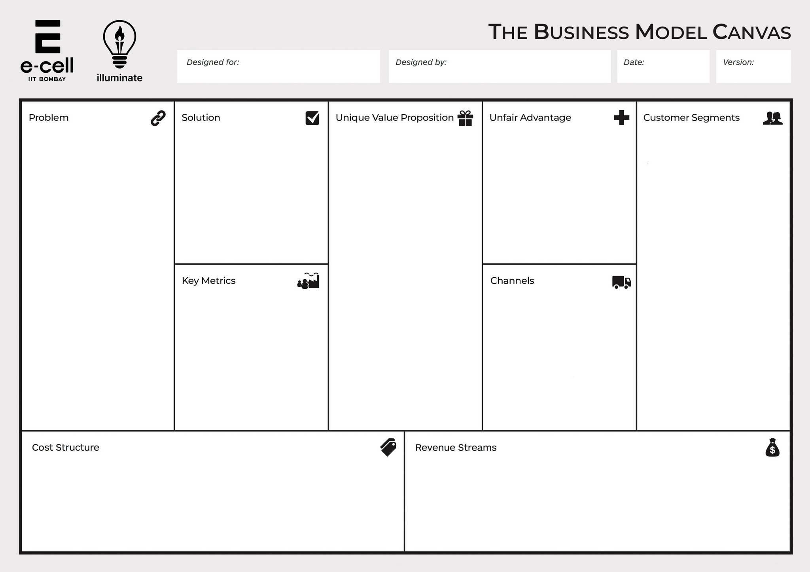

Overwhelming Choices: Travelers are inundated with too many options for accommodations, flights, and activities, leading to decision fatigue.
Lack of Personalization: Current platforms provide generic recommendations that don't align with individual preferences.
Budget Constraints: Many travelers overspend due to inadequate planning tools.
Lack of Real-Time Information: Travelers need updates on flight changes, hotel availability, and destination-specific information for better decision-making.
AI-Powered Personalization: Tailored itineraries based on user preferences and budget.
All-in-One Platform: Integration of flights, hotels, and activities in one platform.
Seamless Experience: Competitive pricing, along with in single payment customer can book flight hotel & Activities.
AI-Powered Personalization
Real-Time Travel Insights
All-in-One Platform (Flight + Hotel + Activities)
Wallet System for Entire Trip
Trip Expense Management
Budget-Friendly Planning
Eco-Friendly Options, Carbon Footprint Calculator
Gamification of Travel Planning (Badges, Rewards, Leaderboards)
Group Travel Collaboration (Shared Wallets, Voting, and Itinerary Sharing)
AI-Powered Packing Assistant
Travel Insurance and Emergency Support
Predictive Travel Recommendations (Trends and Best Booking Times)
Language Translation and Cultural Insights
AR/VR Travel Previews
Personalized Deals and Alerts
Existing Revenue Model: The platform is already generating INR 8-10 lakh per month through offline bookings.
AI-Based Itinerary System: Advanced technology providing personalized and sharable itineraries not readily available elsewhere.
Exclusive Partnerships
Families/ Group Travellers: Seeking stress-free, budget-conscious vacation planning.
Solo Travelers: Looking for customized and hassle-free experiences.
Corporate Travelers: Requiring smooth and efficient trip management.
Influencer Market: Engaging influencers to amplify reach and inspire travel.
User Growth: Targeting 1,000 to 5,000 users by Year 2.
Revenue Milestones: Break-even expected by Year 2.
Trip Success Rates: Positive customer feedback and trip completion rates.
Influencer Campaign Reach: Measuring effectiveness through impressions and bookings.
Website: Current website offering pre-built itineraries and personalization features.
Social Media: Engaging content and collaborations with travel influencers.
YouTube
Corporate Partnerships:
Community Whatsapp Group: Partnering for exclusive local insights and experiences.
Technology Development (e.g., AI systems, website, and app maintenance)
Marketing and Partnerships (e.g., influencer collaborations, campaigns)
Operational Costs (e.g., hosting, customer support)
Employee Salaries (e.g., engineers, designers, AI specialists, deals onboarding, Trip planning and negosiating guys)
Commissions (e.g., payments to travel agents, hotels, or airlines)
R&D (e.g., for new AI features or sustainability tools)
Booking Commissions: Earnings from flights, hotels, activity bookings and Entire trip planning.
Tiered Subscriptions: Free and paid tiers offering enhanced personalization and concierge services.
Advertising & Sponsorships: Partnering with travel brands for visibility.
Data Insights: Selling anonymized insights to travel brands for improving their offerings.
Agents b2b offerings

Slide 12

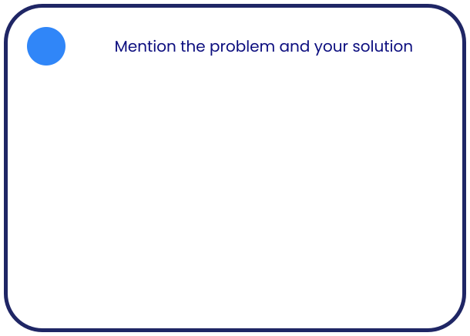


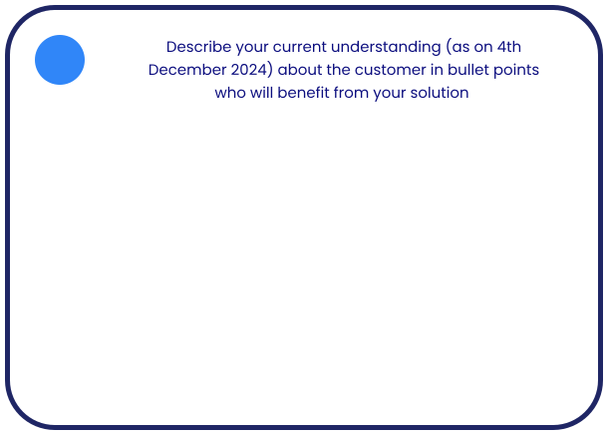
1
3
4
Problem statement: In the fast-paced modern world, organizing a trip is overwhelming due to the abundance of choices for accommodations, flights, and activities. Travelers spend hours searching across multiple platforms, leading to frustration, loss of valuable time, budget overruns, and uncertainty in decision-making.
Solution: Travel Genie provides an AI-powered, all-in-one travel platform offering personalized itineraries, budget-friendly planning, real-time updates, and integrated bookings for flights, hotels, and activities. It simplifies travel planning and ensures a seamless end-to-end experience tailored to individual preferences.
Volume of Inquiries:
Receiving 8-10 inquiries per day over the past year.
Total inquiries handled: ~3,000+ till today.
Types of Inquiries Handled:
Complete Trip Planning Requests:
Customers seeking end-to-end management of their trips, including Flights, Hotels, Cabs/Transport: Reliable, Activities and in one click they want to book.
Lack of transparency in pricing, Poor coordination leading to canceled, Limited customization options.
Guidance for First-Time or Unplanned Travelers: Where to go: suggestions for destinations based on interests , How to go, require a personalized assistant.
Customer Problems Addressed by RoamMyWay
Seamless Trip Management
Restored Confidence by giving them better Experience.
Personalized Guidance: Expert recommendations for destinations, budgets, and itineraries.
Demographics of Ideal Customer:
- Age: 25–40 years , Profession: Working professionals, families, young couples, and solo travelers
- Preferences: Personalized, hassle-free trip planning with budget-friendly options
Top 4-5 Customer Problems:
1. Managing multiple bookings across platforms is confusing.
2. Overwhelmed by too many travel options.
3. Negative experiences with third-party agencies (hidden costs, mismanagement).
4. Lack of knowledge about where and how to plan trips.
5. Exceeding budgets due to lack of tools and transparent pricing.
Key Problem Addressed by Solution:
Simplifies trip planning with an all-in-one platform offering personalized, reliable, and budget-friendly solutions.
2
Customers prioritize convenience and time-saving solutions in their travel planning.
Budget-conscious travelers are seeking tools to avoid overspending while maximizing their travel experiences.
Personalized and real-time updates are crucial to address sudden changes in travel plans (e.g., flight delays, hotel unavailability).
Group travelers require efficient expense management tools, such as pooled budgeting systems.
Eco-conscious travelers show interest in sustainable travel options and carbon footprint calculators.
Primary beneficiaries are working professionals, families, and solo travelers between the ages of 25-45 who frequently travel and prefer a streamlined, integrated travel planning solution.
Evidence of Impact

Slide 13
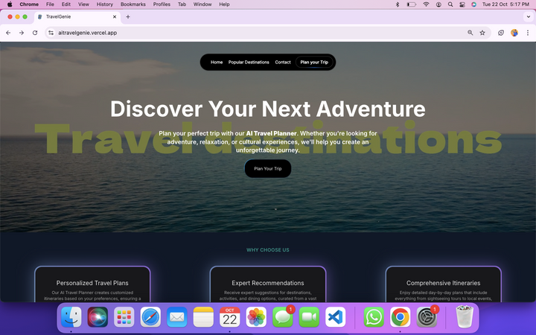
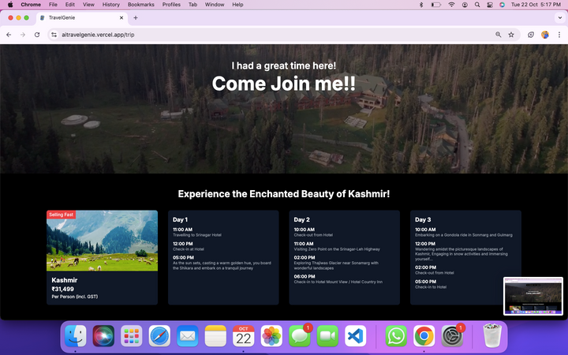

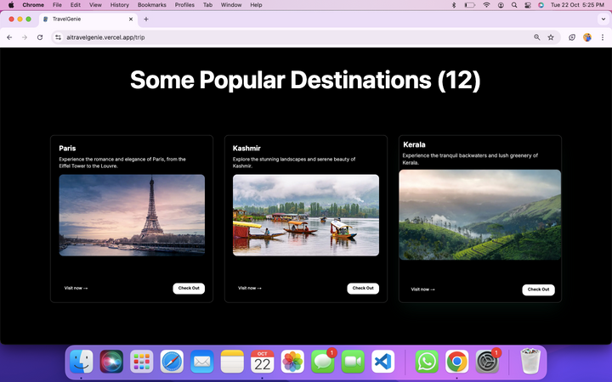
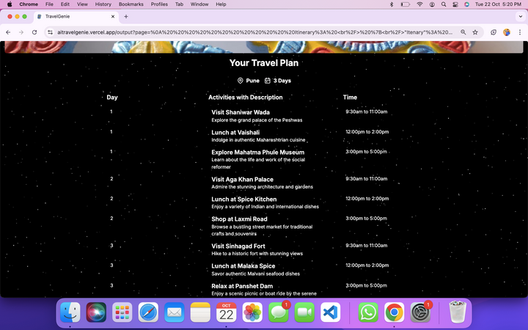

PRODUCT
e
Link: ClickHere
Note: Right now booking is done from 3rd party website Global booking system need to be incorprate.
Right now we are generating the travel Plan only in english we can generate the travel in almost 40 Languages.
Demo Video: Youtube
Unique Features
AI-Powered Personalization
Integrated Booking System
Real-Time Travel Updates

Slide 14



TEAM
Tech Team:
Vidhan Mehta
Sumith Sigtia
Swathi S
Engineering in AI&ML at TOCE
+91 6376200925
LinkedIn
Engineering in
AI&ML at TOCE
+91 86608 35660
Engineering in AI&ML at TOCE
and 5 more...

Slide 15




THANK YOU
Join Us on Our Journey to Revolutionize Travel!
visit our website www.roammyway.in
vidhanmehta3@gmail.com
+91 6376200925
info@roammyway.in
TravelGenie
EU24282342
Chat Bot

